Slide 1
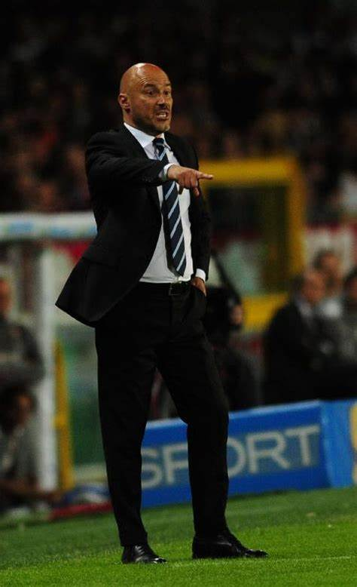
Fulvio Pea
UEFA PRO License 2005
UEFA A License 2002
UEFA B License 1993

Slide 2
EXPERIENCES
CLUB | POSITION | SEASON
HEBAR (BULGARY LEAGUE A) KHORFAKKAN (AEU LEAGUE A) | FIRST TEAM HEAD COACH/TECHNICAL DIRECTOR TECHNICAL CONSULTANT | from 10.06.2022 from 26.02.2022 | at today to 01.06.2022
NANJING CITY (CHINA LEAGUE B) | FIRST TEAM HEAD COACH | from 16.03.2021 | to 31.12.2021
JIANGSU SUNING(CHINA LEAGUE A) | TECHINCAL DIRECTOR | from 10.1.2021 | to 15.03.2021
JIANGSU SUNING(CHINA LEAGUE A) | YOUTH SECTOR TECHNICAL DIRECTOR | from 01.07.2019 | to 09.01.2021
A.S. LIVORNO (ITALY LEAGUE B) | YOUTH SECTOR DIRECTOR | from 01.07.2018 | to 30.06.2019
PRO PIACENZA (ITALY LEAGUE C) | FIRST TEAM HEAD COACH | from 01.07.2016 | to 30.06.2018
CREMONESE (ITALY LEAGUE C) | FIRST TEAM HEAD COACH | from 01.07.2015 | to 28.02.2016
MONZA (ITALY LEAGUE C) | FIRST TEAM HEAD COACH | from 01.07.2014 | to 30.06.2015
JUVESTABIA (ITALY LEAGUE B) | FIRST TEAM HEAD COACH | from 24.11.2013 | to 1.02.2014
PADOVA (ITALY LEAGUE B) | FIRST TEAM HEAD COACH | from 01.07.2012 | to 30.06.2013
SASSUOLO (ITALY LEAGUE B) | FIRST TEAM HEAD COACH | from 01.07.2011 | to 30.06.2012
F.C.INTERNAZIONALE (ITALY LEAGUE A) | UNDER 19 HEAD COACH | from 01.07.2009 | to 30.06.2011
U.C. SAMPDORIA (ITALY LEAGUE A) | UNDER 19 HEAD COACH | from 01.07.2007 | to 30.06.2009
A.S. LUCCHESE (ITALY LEAGUE C) | FIRST TEAM HEAD COACH | from 01.07.2005 | to 30.06.2007
A.C. SIENA (ITALY LEAGUE A) | FIRST TEAM ASSISTAN COACH | from 01.07.2004 | to 27.01.2005
NAPOLI S.S. (ITALY LEAGUE B) | FIRST TEAM ASSISTANT COACH | from 10.10.2003 | to 30.06.2004
ANCONA CALCIO (ITALY LEAGUE B) | FIRST TEAM ASSISTANT COACH | from 01.07.2002 | to 30.06.2003
CSKA SOFIA (BULGARY LEAGUE A) | YOUTH SECTOR DIRECTOR | from 01.11.2001 | to 30.06.2002
RAVENNA CALCIO (ITALY LEAGUE B) | UNDER 17 HEAD COACH | from 01.07.2000 | to 30.10.2001
F.C.INTERNAZIONALE (ITALY LEAGUE A) | UNDER 13 HEAD COACH | from 01.07.1998 | to 30.06.2000

Slide 3
PALMARES
CLUB | YEAR | CATEGORY | TITLE
SASSUOLO | 2011/12 | SERIE B | 3° PLACE PLAY OFF
F.C. INTERNAZIONALE | 2009/10 | PRIMAVERA | 1° PLACE CHAMPION’S LEAGUE U18
F.C. INTERNAZIONALE | 2010/11 | PRIMAVERA | 1° PLACE COPPA CARNEVALE VIAREGGIO
U.C. SAMPDORIA | 2007/08 | PRIMAVERA | CAMPIONE D’ITALIA SCUDETTO PRIMAVERA
U.C. SAMPDORIA | 2007/08 | PRIMAVERA | 1° PLACE COPPA ITALIA
U.C. SAMPDORIA | 2008/09 | PRIMAVERA | 1° PLACE SUPERCOPPA ITALIANA
ANCONA CALCIO | 2002/03 | SERIE B | SERIE A PROMOTION (G.Simoni assistant coach)

Slide 4
PERSONAL PROFILE
HONOURABLE COLLABORATIONS:
- Roberto Samaden (as a collaborator) in Internazionale in 1998 and 2010;
my Inter comeback has coincided with both Samaden’s nominee for Youth Sector Direcor and Piero Ausilio’s First Team Sports Director. In this time I have also been following Jose Mourinho’s workings.
Gigi Simoni. Thanks to “the Mister” I’ve been able to complete my personal professional route: first as da an assistan Coach for Ancona, Napoli and Siena, and then as Head Coach for Lucchese.
Beppe Marotta, Fabio Paratici e Roberto Sassi whean I was training the Sampdoria Primavera (2007/2009)
Salvatore Bagni, organizer, in partnership with Nike, of the “Scuole Calcio Estive di Gatteo a Mare”, as a collaborator and an instructor from 1994 to1998. During this experience I’ve had the honour to continuously work with the legend Diego Armando Maradona.
From 2016 to 2019 I was an instructor at the Summer Campus “Città di Baveno”, with my friends Squizzi (former Juve player, now coaching goalkeepers for ChievoVerona), Sorrentino (ChievoVerona player) and Gallo (former Atalanta and Torino player).

Slide 5
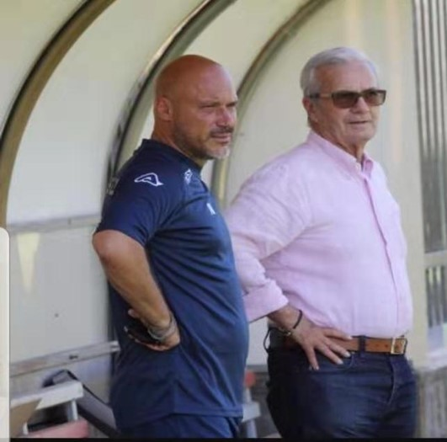
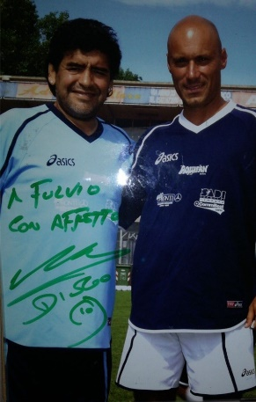
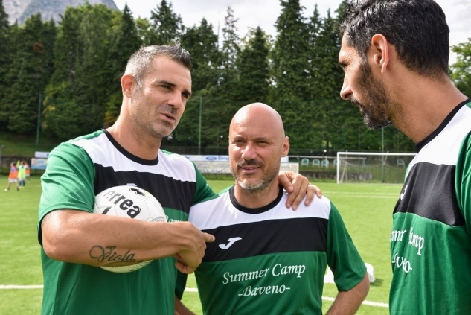
PROFESSIONAL EXPERIENCES
ABROAD EXPERIENCES with FC INTERNAZIONALE partner companies
QINGDAO (China) stage: youth director technical coordinator .
BRNO (Czech Republic) stage: youth director technical coordinator.
INTERCAMPUS: training courses instructor, in some foreing realities involved with
Inter campus and Academy Inter.
ESPERIENZE IN ITALY in FC INTERNAZIONALE summer camps
ALBARELLA (Italy) stage: summer camp techincal coordinator.
PINZOLO (Italy) stage: summer camp techincalcoordinator.

Slide 6
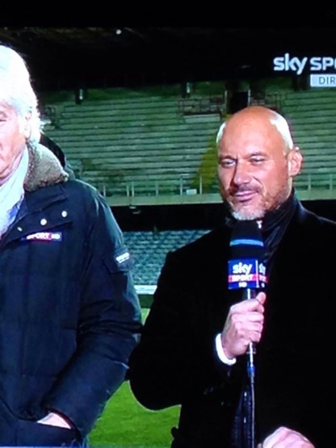
PROFESSIONAL EXPERIENCES
SPORTS AWARDS PRIZE: GENTLEMENT dell'ANNO
I’ve took part in the december 2015 edition of the top prize held by “Gazzetta dello Sport” with Roberto Donadoni (Parma head Choach) and Jmaes Pallotta ( former Roma president).
SPORTITALIA
“Finals eight“ and Supercoppa Italiana category Primavera techincal Commentator.
SKY SPORT
-Serie B technical commentator;
-Youth League technical commentator;
-Technical co-host, for Skytg24 sport, video analysis andtactical presentation, for the Serie A weekend top matches.

Slide 7
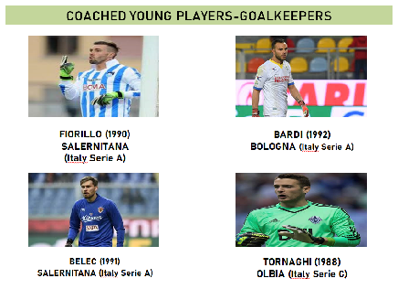
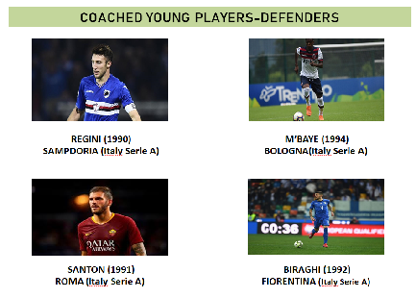
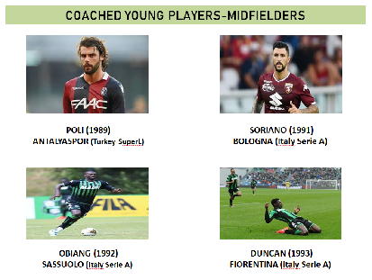
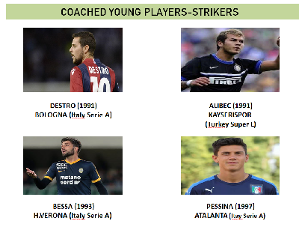
KEY PLAYERS I WORKED WITH

Slide 8
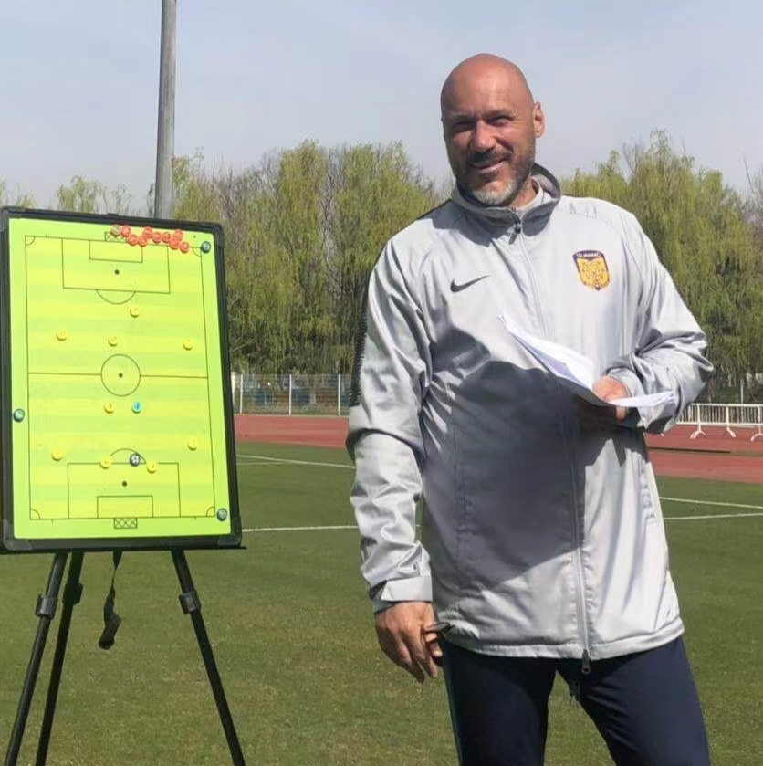
Fulvio Pea
DATE OF BIRTH 10.02.1967
PLACE Casalpusterlengo (Lo, Italia)
TELEPHONE +393357118752 (Whatsapp)
SKYPE aa3fe60e93fa563
WECHAT 13151532762
EMAIL ADDRESSES fulviopea@hotmail.com
fulviopea@hotmail.it

